Slide 1
Introduction to Computer Organization, Basic Structure and Instruction Set Architecture
Subramaniam Ganesan, Professor,
Oakland University,
School of Engineering and Computer Science,
Rochester, MI 48309, USA.
ganesan@oakland.edu
References:
William Stallings Computer Organization and Architecture, 8th Edition
Carl Hamacher etal., Computer Organization
Review for FPGA Course

Slide 2
Objective of this lecture
At the end of the lesson you will be able to:
understand basic organization of computer system
understand the meaning of Arithmetic Logical Unit, Control Unit and Central Processing Unit
define computer memory
differentiate between primary memory and secondary memory
differentiate between primary storage and secondary storage units
Identify input devices and output devices

Slide 3
Computer organization is a study of a Computer Architecture.
E.g. Memory, Registers, RAM, ROM, CPU, ALU, 16 bit/ 32 bit/ 64 bit architecture, what different parts makes a computer, etc. How various blocks are organized and interact with each other.

Slide 4
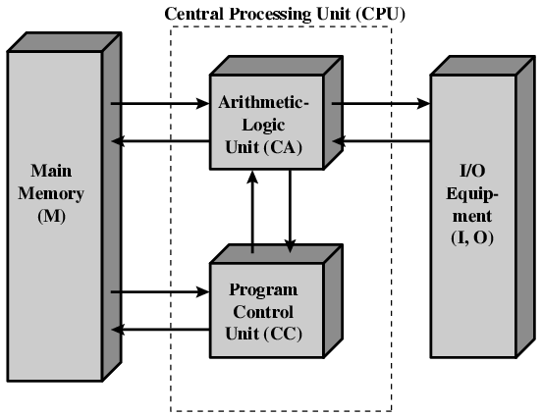
Structure of von Neumann machine

Slide 5
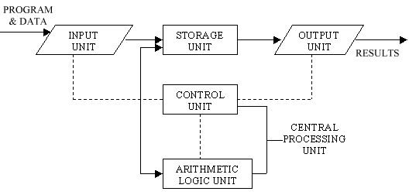
Basic Computer Operations

Slide 6
Computer operations
Input: This is the process of entering data and programs in to the computer system. You should know that computer is an electronic machine like any other machine which takes as inputs raw data and performs some processing giving out processed data. Therefore, the input unit takes data from us to the computer in an organized manner for processing.
Storage: The process of saving data and instructions permanently is known as storage. Data has to be fed into the system before the actual processing starts. It is because the processing speed of Central Processing Unit (CPU) is so fast that the data has to be provided to CPU with the same speed. Therefore the data is first stored in the storage unit for faster access and processing.

Slide 7
The storage unit performs the following major functions:
All data and instructions are stored here before and after processing.
Intermediate results of processing are also stored here.
Processing: The task of performing operations like arithmetic and logical operations is called processing. The Central Processing Unit (CPU) takes data and instructions from the storage unit and makes all sorts of calculations based on the instructions given and the type of data provided. It is then sent back to the storage unit.
.

Slide 8
4. Output: This is the process of producing results from the data for getting useful information. Similarly the output produced by the computer after processing must also be kept somewhere inside the computer before being given to you in human readable form. Again the output is also stored inside the computer for further processing.
5. Control: The manner how instructions are executed and the above operations are performed. Controlling of all operations like input, processing and output are performed by control unit. It takes care of step by step processing of all operations in side the computer

Slide 9
FUNCTIONAL UNITS
The Functional Units are
      arithmetic logical unit,
      control unit, and
      central processing unit.
2.4.1 Arithmetic Logical Unit (ALU)
The actual processing of the data and instruction are performed by Arithmetic Logical Unit. The major operations performed by the ALU are addition, subtraction, multiplication, division, logic and comparison. Data is transferred to ALU from storage unit when required. After processing the output is returned back to storage unit for further processing or getting stored.

Slide 10
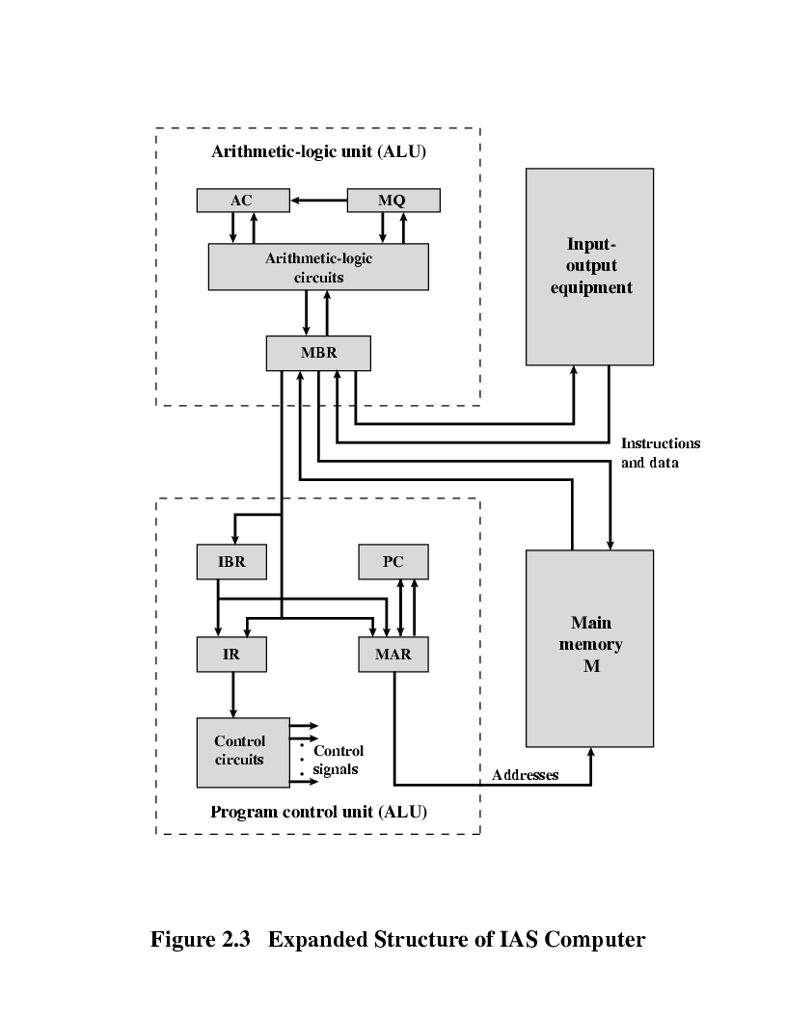
More Details of ALU

Slide 11
Connection Between the Processor and the Memory

Slide 12
Control Unit (CU)
The Control Unit acts like the supervisor. The control unit determines the sequence in which computer programs and instructions are executed. Things like processing of programs stored in the main memory, interpretation of the instructions and issuing of signals for other units of the computer to execute them. It coordinates the activities of computer’s peripheral equipment as they perform the input and output.

Slide 13
Central Processing Unit (CPU)
The ALU and the CU of a computer system are jointly known as the central processing unit.
You may call CPU as the brain of any computer system. It is just like brain that takes all major decisions, makes all sorts of calculations and directs different parts of the computer functions by activating and controlling the operations.

Slide 14
Memory
There are two kinds of computer memory: primary and secondary. Primary memory is accessible directly by the processing unit. RAM is an example of primary memory.
As soon as the computer is switched off the contents of the primary memory is lost. You can store and retrieve data much faster with primary memory compared to secondary memory.
Secondary memory such as floppy disks, magnetic disk, etc., is located outside the computer. Primary memory is more expensive than secondary memory. Because of this the size of primary memory is less than that of secondary memory.

Slide 15
Random Access Memory (RAM): The primary storage is referred to as random access memory (RAM) because it is possible to randomly select and use any location of the memory directly store and retrieve data. The memories, which loose their content on failure of power supply, are known as volatile memories. RAM is volatile memory.
Read Only Memory (ROM) The storage of program and data in the ROM is permanent. The ROM stores some standard processing programs supplied by the manufacturers to operate the computer. The memories, which do not loose their content on failure of power supply, are known as non-volatile memories. ROM is non-volatile memory.

Slide 16
PROM There is another type of primary memory in computer, which is called Programmable Read Only Memory (PROM). You know that it is not possible to modify or erase programs stored in ROM, but it is possible for you to store your program in PROM chip. Once the programs are written it cannot be changed and remain intact even if power is switched off. Therefore programs or instructions written in PROM or ROM cannot be erased or changed.
EPROM: This stands for Erasable Programmable Read Only Memory, which over come the problem of PROM & ROM. EPROM chip can be programmed time and again by erasing the information stored earlier in it. Information stored in EPROM exposing the chip for some time ultraviolet light and it erases chip is reprogrammed using a special programming facility. When the EPROM is in use information can only be read.

Slide 17
Cache Memory: The speed of CPU is extremely high compared to the access time of main memory. CACHE memory is attached between CPU and Main memory. CACHE memory access time is very close to the processing speed of CPU. CACHE memories are accessed much faster than conventional RAM. It is used to store programs or data currently being executed or temporary data frequently used by the CPU. So each memory makes main memory to be faster and larger than it really is. It is also very expensive to have bigger size of cache memory and its size is normally kept small.
Registers: The CPU processes data and instructions with high speed, there is also movement of data between various units of computer. It is necessary to transfer the processed data with high speed. So the computer uses a number of special memory units called registers. They are not part of the main memory but they store data or information temporarily and pass it on as directed by the control unit.

Slide 18
Generations of Computer
Vacuum tube - 1946-1957– Generation 1
Transistor - 1958-1964 -- Generation 2
Small scale integration - 1965 on
  Up to 100 devices on a chip
Medium scale integration - to 1971
  100-3,000 devices on a chip
Large scale integration - 1971-1977– Generation 3
  3,000 - 100,000 devices on a chip
Very large scale integration - 1978 -1991
  100,000 - 100,000,000 devices on a chip
Ultra large scale integration – 1991 – Generation 4
  Over 100,000,000 devices on a chip

Slide 19
Moore’s Law
Increased density of components on chip
Gordon Moore – co-founder of Intel
Number of transistors on a chip will double every year
Since 1970’s development has slowed a little
  Number of transistors doubles every 18 months
Cost of a chip has remained almost unchanged
Higher packing density means shorter electrical paths, giving higher performance
Smaller size gives increased flexibility
Reduced power and cooling requirements
Fewer interconnections increases reliability

Slide 20
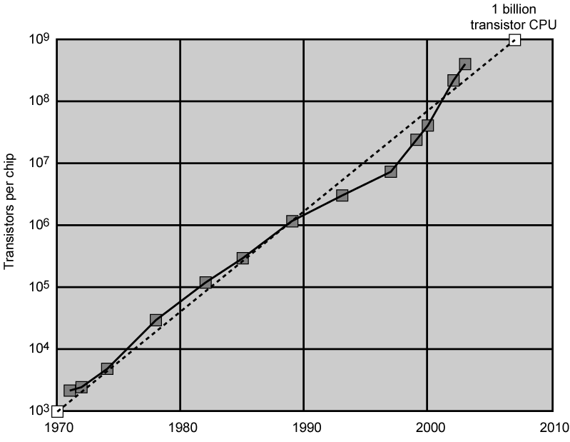
Growth in CPU Transistor Count
Altera’s Stratix FPGA contains (2011) 3.9 Billion Transistors

Slide 21
DEC PDP-8
1964
First minicomputer
Did not need air conditioned room
Small enough to sit on a lab bench
$16,000
  $100k+ for IBM 360
Embedded applications & OEM
BUS STRUCTURE

Slide 22
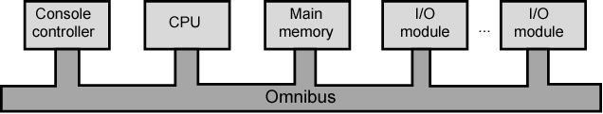
DEC - PDP-8 Bus Structure

Slide 23
To Speed a computer Performance
Pipelining
On board cache
On board L1 & L2 cache
Branch prediction
Data flow analysis
Speculative execution
[ We will learn these terms later]

Slide 24
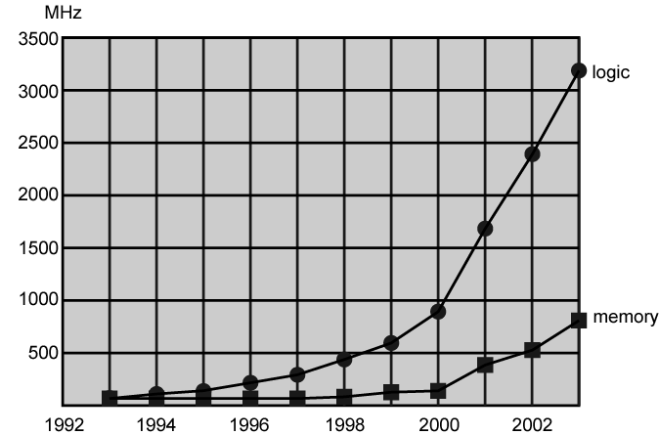
Login and Memory Performance Gap

Slide 25
Performance Balance
Processor speed increased
Memory capacity increased
Memory speed lags behind processor speed
But, the memory and processor performance gap is reducing due to Cache memory, advances in technology etc

Slide 26
Solutions
Increase number of bits retrieved at one time
  Make DRAM “wider” rather than “deeper”
Change DRAM interface
  Cache
Reduce frequency of memory access
  More complex cache and cache on chip
Increase interconnection bandwidth
  High speed buses
  Hierarchy of buses

Slide 27
I/O Devices
Peripherals with intensive I/O demands
Large data throughput demands
Processors can handle this
Problem moving data
Solutions:
  Caching
  Buffering
  Higher-speed interconnection buses
  More elaborate bus structures
  Multiple-processor configurations

Slide 28
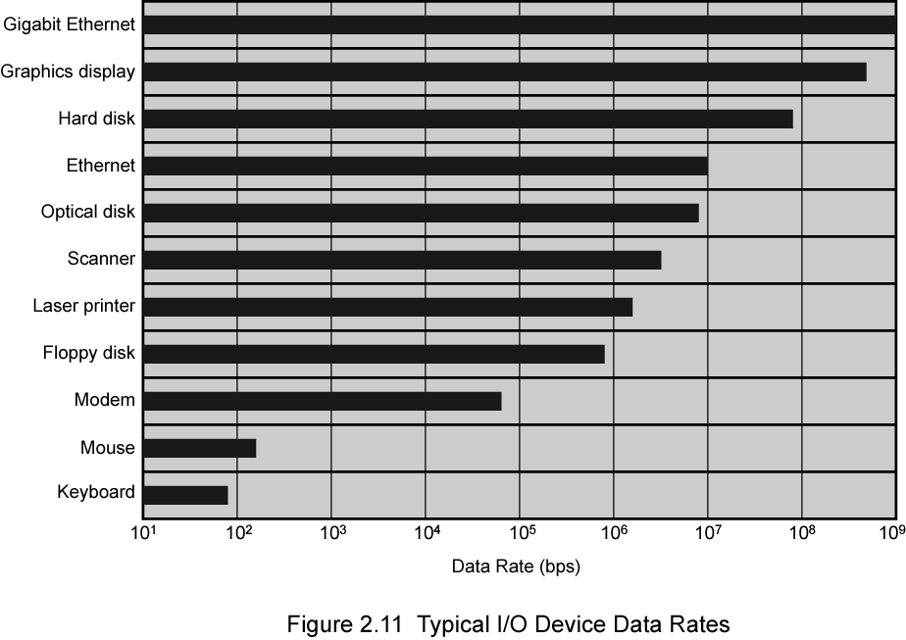
Typical I/O Device Data Rates

Slide 29
Key is Balance
Processor components
Main memory
I/O devices
Interconnection structures

Slide 30
Improvements in Chip Organization and Architecture
Increase hardware speed of processor
  Fundamentally due to shrinking logic gate size
    More gates, packed more tightly, increasing clock rate
    Propagation time for signals reduced
Increase size and speed of caches
  Dedicating part of processor chip
    Cache access times drop significantly
Change processor organization and architecture
  Increase effective speed of execution
  Parallelism

Slide 31
Problems with Clock Speed and Login Density
Power
  Power density increases with density of logic and clock speed
  Dissipating heat
RC delay
  Speed at which electrons flow limited by resistance and capacitance of metal wires connecting them
  Delay increases as RC product increases
  Wire interconnects thinner, increasing resistance
  Wires closer together, increasing capacitance
Memory latency
  Memory speeds lag processor speeds
Solution:
  More emphasis on organizational and architectural approaches

Slide 32
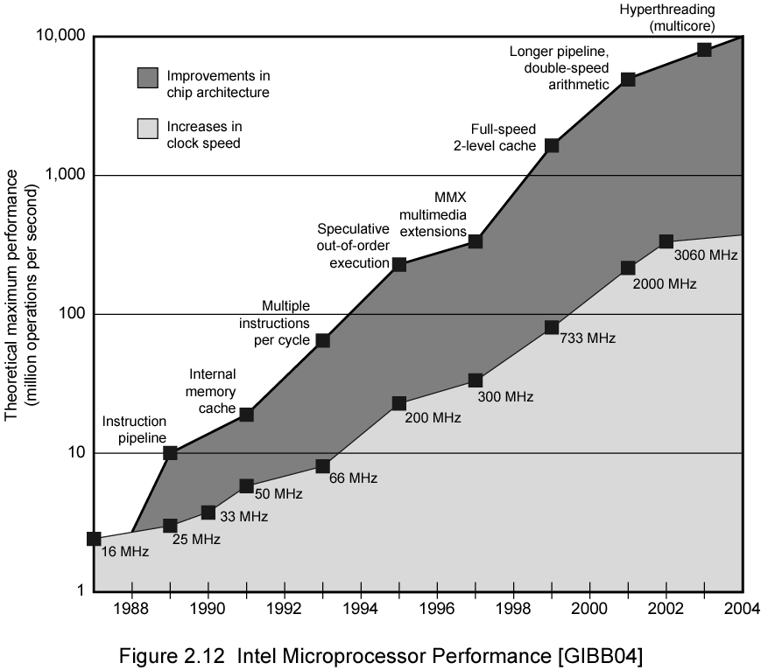
Intel Microprocessor Performance

Slide 33
Increased Cache Capacity
Typically two or three levels of cache between processor and main memory
Chip density increased
  More cache memory on chip
    Faster cache access
Pentium chip devoted about 10% of chip area to cache
Pentium 4 devotes about 50%

Slide 34
Diminishing Returns
Internal organization of processors complex
  Can get a great deal of parallelism
  Further significant increases likely to be relatively modest
Benefits from cache are reaching limit
Increasing clock rate runs into power dissipation problem
  Some fundamental physical limits are being reached

Slide 35
New Approach – Multiple Cores
Multiple processors on single chip
  Large shared cache
Within a processor, increase in performance proportional to square root of increase in complexity
If software can use multiple processors, doubling number of processors almost doubles performance
So, use two simpler processors on the chip rather than one more complex processor
With two processors, larger caches are justified
  Power consumption of memory logic less than processing logic

Slide 36
x86 Evolution (1)
8080
  first general purpose microprocessor
  8 bit data path
  Used in first personal computer – Altair
8086 – 5MHz – 29,000 transistors
  much more powerful
  16 bit
  instruction cache, prefetch few instructions
  8088 (8 bit external bus) used in first IBM PC
80286
  16 Mbyte memory addressable
  up from 1Mb
80386
  32 bit
  Support for multitasking
80486
  sophisticated powerful cache and instruction pipelining
  built in maths co-processor

Slide 37
x86 Evolution (2)
Pentium
  Superscalar
  Multiple instructions executed in parallel
Pentium Pro
  Increased superscalar organization
  Aggressive register renaming
  branch prediction
  data flow analysis
  speculative execution
Pentium II
  MMX technology
  graphics, video & audio processing
Pentium III
  Additional floating point instructions for 3D graphics

Slide 38
x86 Evolution (3)
Pentium 4
  Note Arabic rather than Roman numerals
  Further floating point and multimedia enhancements
Core
  First x86 with dual core
Core 2
  64 bit architecture
Core 2 Quad – 3GHz – 820 million transistors
  Four processors on chip
x86 architecture dominant outside embedded systems
Organization and technology changed dramatically
Instruction set architecture evolved with backwards compatibility
~1 instruction per month added
500 instructions available
See Intel web pages for detailed information on processors

Slide 39
Embedded Systems
ARM
ARM evolved from RISC design
Used mainly in embedded systems
  Used within product
  Not general purpose computer
  Dedicated function
  E.g. Anti-lock brakes in car

Slide 40
Embedded Systems Requirements
Different sizes
  Different constraints, optimization, reuse
Different requirements
  Safety, reliability, real-time, flexibility, legislation
  Lifespan
  Environmental conditions
  Static v dynamic loads
  Slow to fast speeds
  Computation v I/O intensive
  Descrete event v continuous dynamics

Slide 41
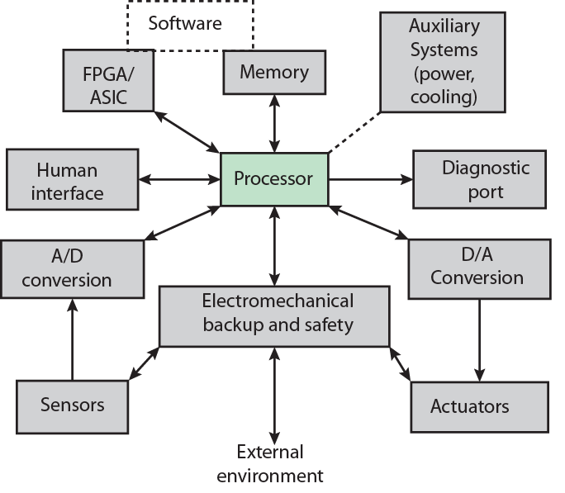
Possible Organization of an Embedded System

Slide 42
ARM Evolution
Designed by ARM Inc., Cambridge, England
Licensed to manufacturers
High speed, small die, low power consumption
PDAs, hand held games, phones
  E.g. iPod, iPhone
Acorn produced ARM1 & ARM2 in 1985 and ARM3 in 1989
Acorn, VLSI and Apple Computer founded ARM Ltd.

Slide 43
Performance Assessment
Clock Speed
Key parameters
  Performance, cost, size, security, reliability, power consumption
System clock speed
  In Hz or multiples of
  Clock rate, clock cycle, clock tick, cycle time
Signals in CPU take time to settle down to 1 or 0
Signals may change at different speeds
Operations need to be synchronised
Instruction execution in discrete steps
  Fetch, decode, load and store, arithmetic or logical
  Usually require multiple clock cycles per instruction
Pipelining gives simultaneous execution of instructions
So, clock speed is not the whole story

Slide 44
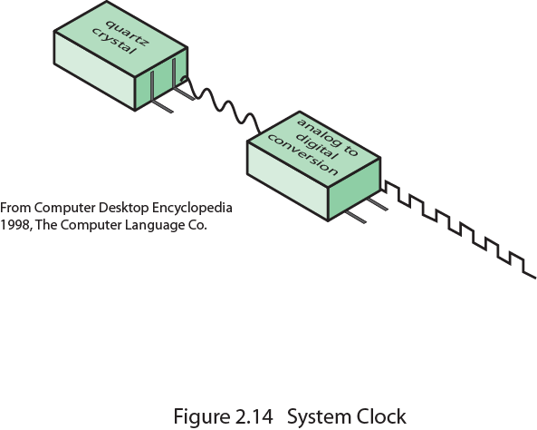
System Clock

Slide 45
Instruction Execution Rate
Millions of instructions per second (MIPS)
Millions of floating point instructions per second (MFLOPS)
Heavily dependent on instruction set, compiler design, processor implementation, cache & memory hierarchy

Slide 46
Benchmarks
Programs designed to test performance
Written in high level language
  Portable
Represents style of task
  Systems, numerical, commercial
Easily measured
Widely distributed
E.g. System Performance Evaluation Corporation (SPEC)
  CPU2006 for computation bound
    17 floating point programs in C, C++, Fortran
    12 integer programs in C, C++
    3 million lines of code
  Speed and rate metrics
    Single task and throughput
    10.51 Petaflop/s on the Linpack benchmark using 705,024 SPARC64 processing cores. -- Japan’s K Computer – Super Computer
Name | FLOPS
yottaFLOPS | 10²⁴
zettaFLOPS | 10²¹
exaFLOPS | 10¹⁸
petaFLOPS | 10¹⁵
teraFLOPS | 10¹²
gigaFLOPS | 10⁹
megaFLOPS | 10⁶
kiloFLOPS | 10³
Computer performance

Slide 47

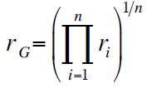
SPEC Speed Metric
Single task
Base runtime defined for each benchmark using reference machine
Results are reported as ratio of reference time to system run time
  Tref_{i} execution time for benchmark i on reference machine
  Tsut_{i} execution time of benchmark i on test system
Overall performance calculated by averaging ratios for all 12 integer benchmarks
  Use geometric mean
    Appropriate for normalized numbers such as ratios

Slide 48
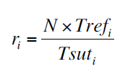
SPEC Rate Metric
Measures throughput or rate of a machine carrying out a number of tasks
Multiple copies of benchmarks run simultaneously
  Typically, same as number of processors
Ratio is calculated as follows:
  Tref_{i} reference execution time for benchmark i
  N number of copies run simultaneously
  Tsuti elapsed time from start of execution of program on all N processors until completion of all copies of program
  Again, a geometric mean is calculated

Slide 49
Amdahl’s Law
Gene Amdahl [AMDA67]
Potential speed up of program using multiple processors
Concluded that:
  Code needs to be parallelizable
  Speed up is bound, giving diminishing returns for more processors
Task dependent
  Servers gain by maintaining multiple connections on multiple processors
  Databases can be split into parallel tasks

Slide 50
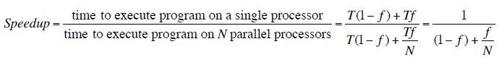
Amdahl’s Law Formula
For program running on single processor
  Fraction f of code infinitely parallelizable with no scheduling overhead
  Fraction (1-f) of code inherently serial
  T is total execution time for program on single processor
  N is number of processors that fully exploit parralle portions of code
Conclusions
  f small, parallel processors has little effect
  N ->∞, speedup bound by 1/(1 – f)
    Diminishing returns for using more processors
We learn about speedup in another lecture.

